Slide 1
Week 4

Slide 2
Explain what is generative AI
List what are some Natural Language Processing (NLP) tasks and understand what are Large Language Models and foundation models.
Apply prompt engineering into Large Language Models
Explain and compare different kinds of customizations for foundational models through fine-tuning and Retrieval Augmented Generation
Discuss Human feedback
Outline the generative AI project lifecycle
Explain AI agents and agentic AI
Design prototypes for NLP tasks

Slide 3













Generative AI
Whether it be a chat bot, generating images from text, or
using a plugin to help you develop code, what you see in these tools is a machine
that is capable of creating content that mimics or approximates human ability.
Generative AI is a subset of traditional machine learning.
And the machine learning models that underpin generative AI have
learned these abilities by finding statistical patterns in massive
datasets of content that was originally generated by humans.
Large language models have been trained on trillions of words over many weeks and
months, and with large amounts of compute power.
These foundation models, as we call them, with billions of parameters,
exhibit emergent properties beyond language alone, and researchers
are unlocking their ability to break down complex tasks, reason, and problem solve.
Here are a collection of foundation models, sometimes called base models,
and their relative size in terms of their parameters

Slide 4


Language
The way you interact with language models is quite different than other machine
learning and programming paradigms.
In contrast, large language models are able to take natural language or
human written instructions and perform tasks much as a human would.
The text that you pass to an LLM is known as a prompt.
The space or memory that is available to the prompt is called the context window,
and this is typically large enough for a few thousand words, but
differs from model to model.
You can fine tune a fondational model, meaning you can make it better to solve particular tasks. Or even train an LLM from scratch.
including images, video, audio, and

Slide 5
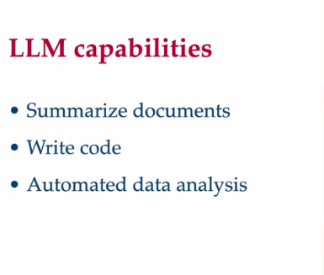
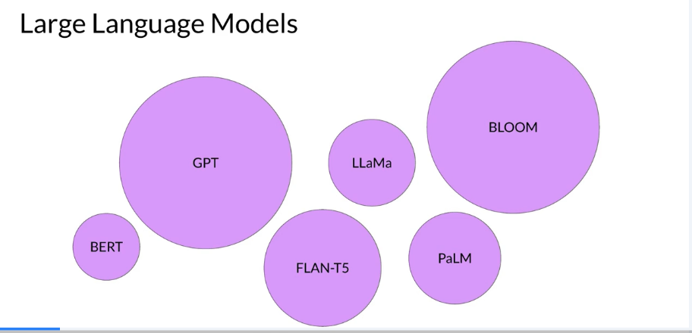
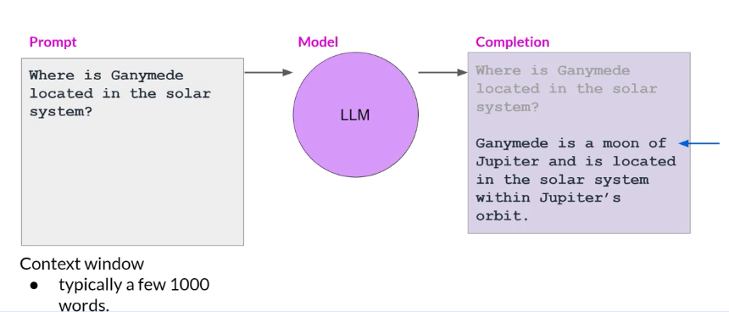






Translation, essay writing, coding, summarization,
Information retrieval
Connecting them to external databases
and resources so that interacts with the real world
Notes:
.
However, you can use this conceptually simple technique
for a variety of other tasks within text generation.
For example, you can ask a model
to write an essay based on a prompt,
to summarize conversations where you
provide the dialogue as part of your prompt and
the model uses this data along with
its understanding of natural language
to generate a summary.
You can use models for a variety of translation tasks
from traditional translation
between two different languages,
such as French and German,
or English and Spanish.
Or to translate natural language to machine code.
For example, you could ask a model to write
some Python code that will return the mean of
every column in a DataFrame and the model will
generate code that you can pass to an interpreter.
You can use LLMs to carry out smaller,
focused tasks like information retrieval.
In this example, you ask the model to identify all of
the people and places identified in a news article.
This is known as
named entity recognition, a word classification.
The understanding of knowle

Slide 6
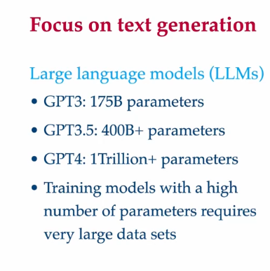

Computationally expensive

Slide 7
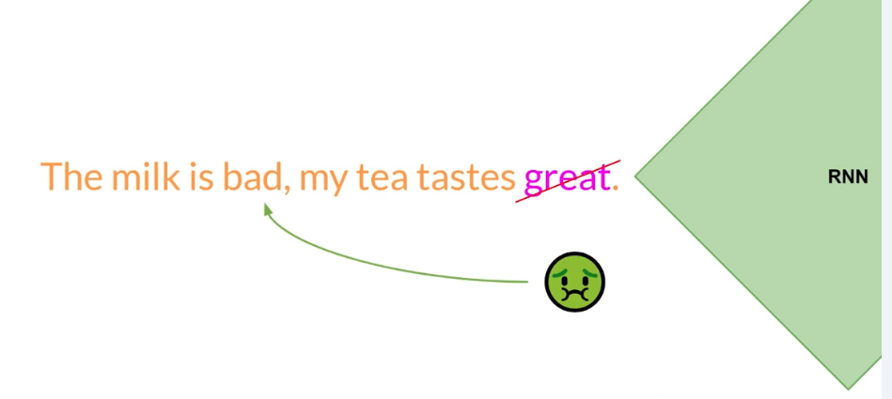














The basic framework is the sequence-to-sequence (seq2seq) model:
Encoder RNN: Reads the input text (e.g., a document) one token at a time and encodes it into a fixed-length context vector (a summary of the input).
Decoder RNN: Takes this context vector and generates a summary, one word at a time.
This architecture was originally designed for machine translation but adapted for summarization.
I traveled to fish at a river but before going I got some money from the bank

Slide 8
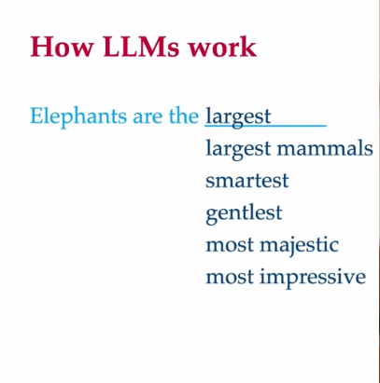
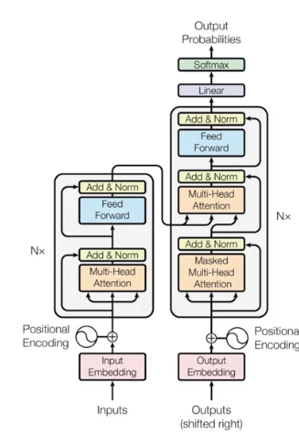








It can be scaled efficiently to use multi-core GPUs,
it can parallel process input data,
making use of much larger
contexts, and crucially,
It introduces the attention mechanism
to the meaning of the words it's processing.
And attention is all you need
Transformer architecture

Slide 9
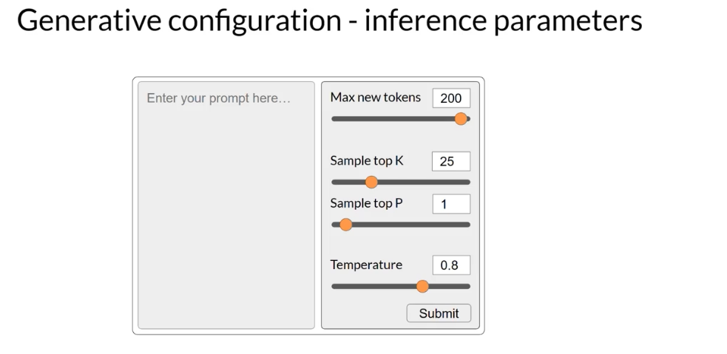


Slide 10
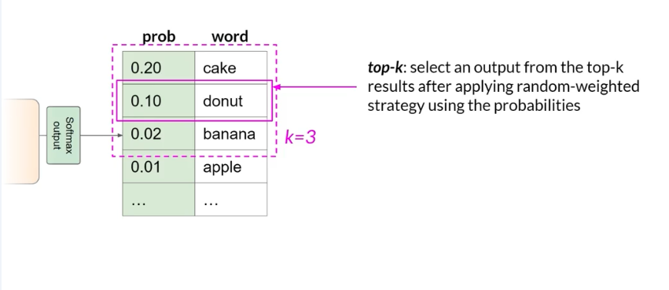
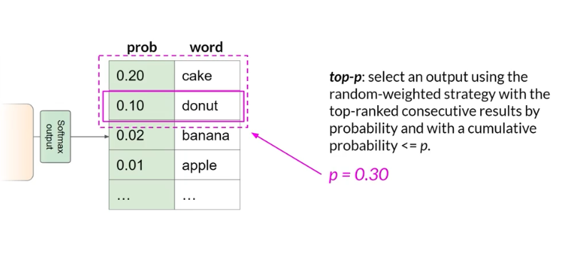
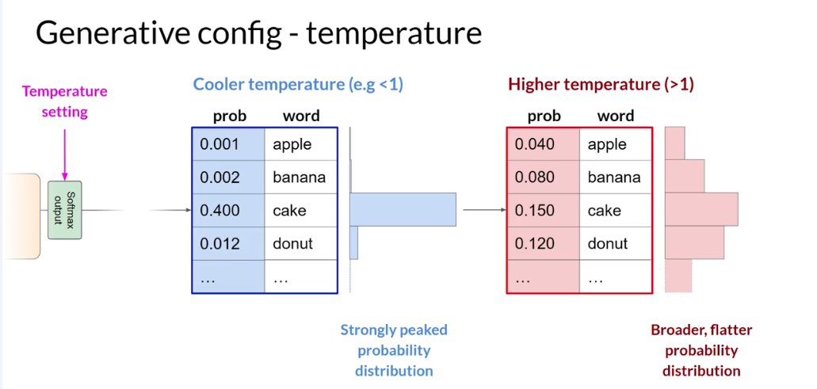








Slide 11
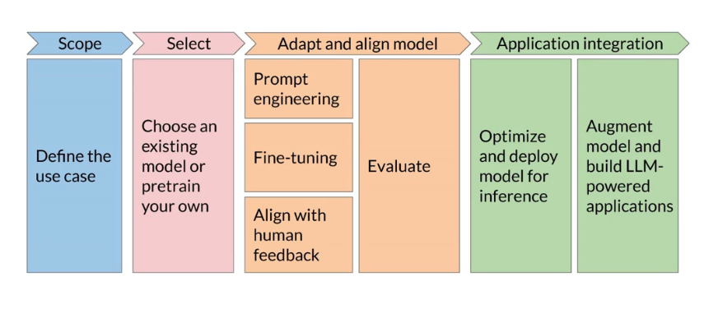



Slide 12
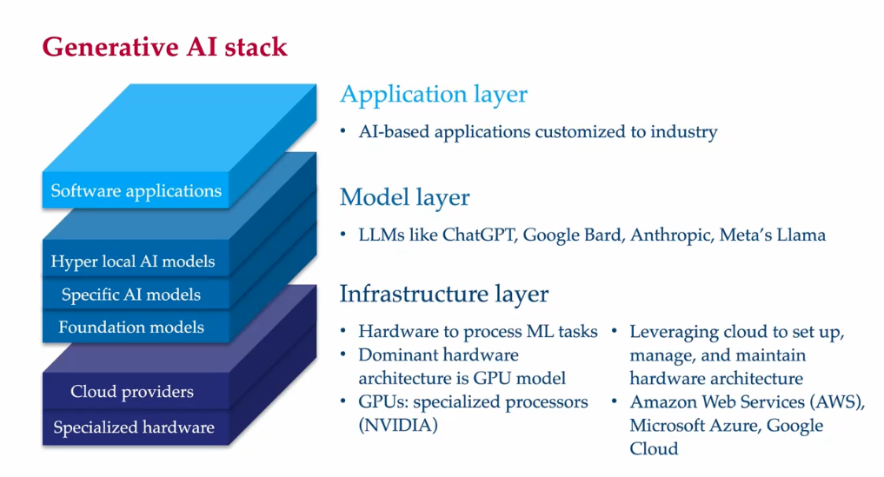




Slide 13















Slide 14





Slide 15
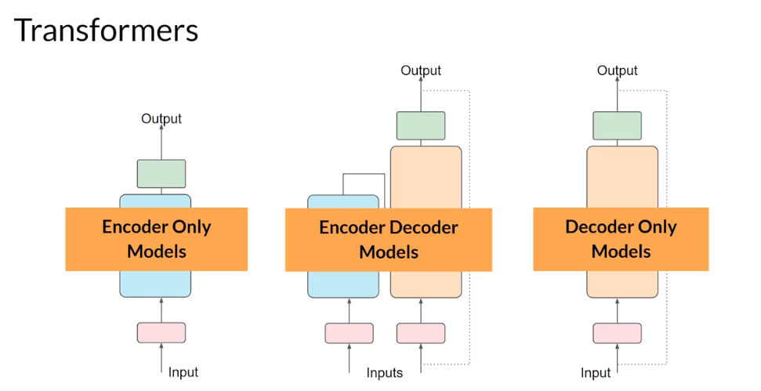
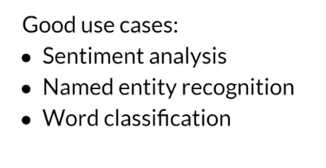
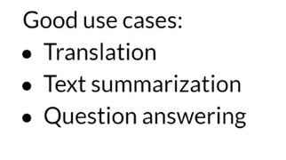
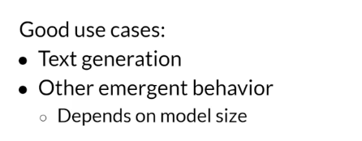
Notes:
Yes, ChatGPT is a decoder-only model. It is based on the Transformer architecture, specifically using the decoder part of the Transformer. This means the model predicts the next token in a sequence by considering only the tokens that come before it, not the entire input sequence.
Elaboration:
Transformer Architecture:
The Transformer architecture is a neural network model that uses attention mechanisms to process sequential data like text. It typically has two main components: an encoder and a decoder.
Decoder-Only:
ChatGPT uses only the decoder part of the Transformer, which means it focuses on generating text based on the previous input tokens, not on encoding the entire input.
Self-Attention:
The decoder uses a self-attention mechanism, which allows it to weigh the importance of different tokens in the input sequence when generating the next token.
Autoregressive:
Decoder-only models are also known as autoregressive models, as they generate text sequentially, one token at a time, based on the previously generated tokens.
GPT Family:
ChatGPT is part of the GPT (Generative Pre-trained Transformer) family of models, which are all based on the decoder-only Transformer architecture.

Slide 16
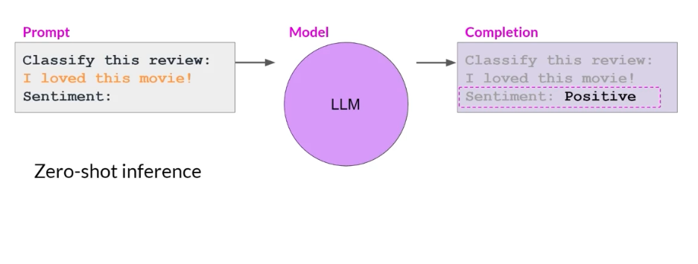
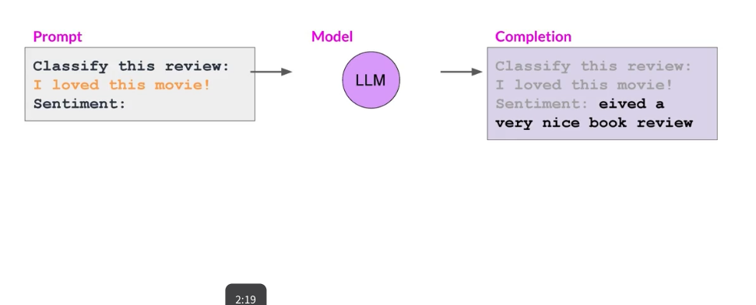
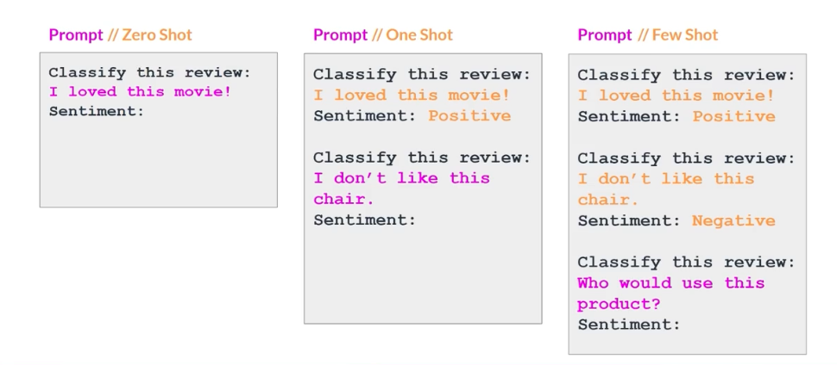
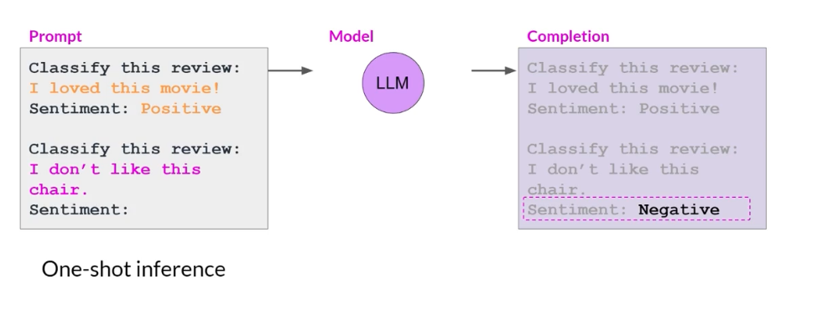
Prompt Engineering
Large models
Smaller models
Notes:
If few shot inference does not work, than, you should fine tune! We will talk more about that

Slide 17
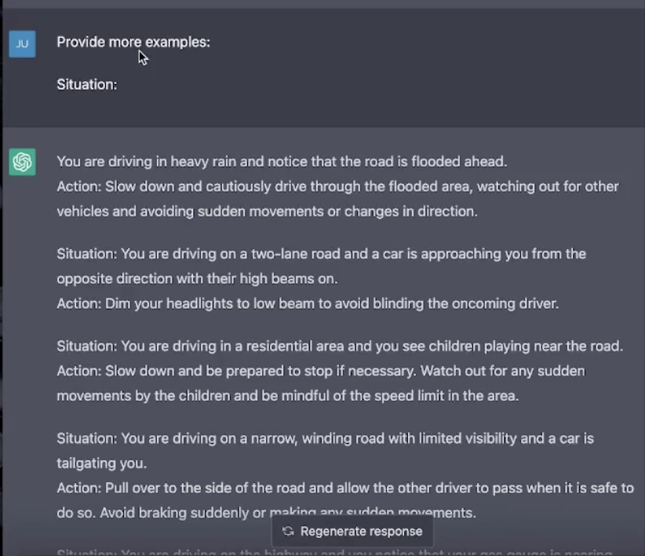
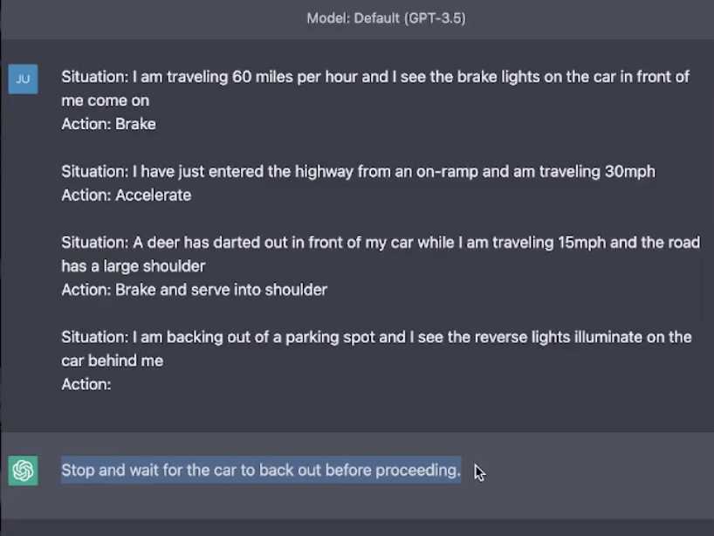
Prompt pattern
Structuring our statements
Yes or no answer, consistent behaviour, how to structure the model answer

Slide 18
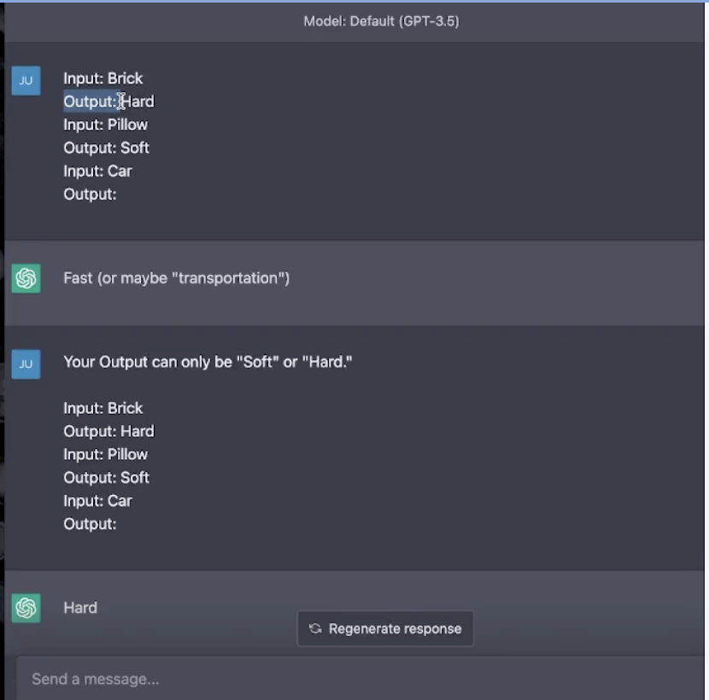
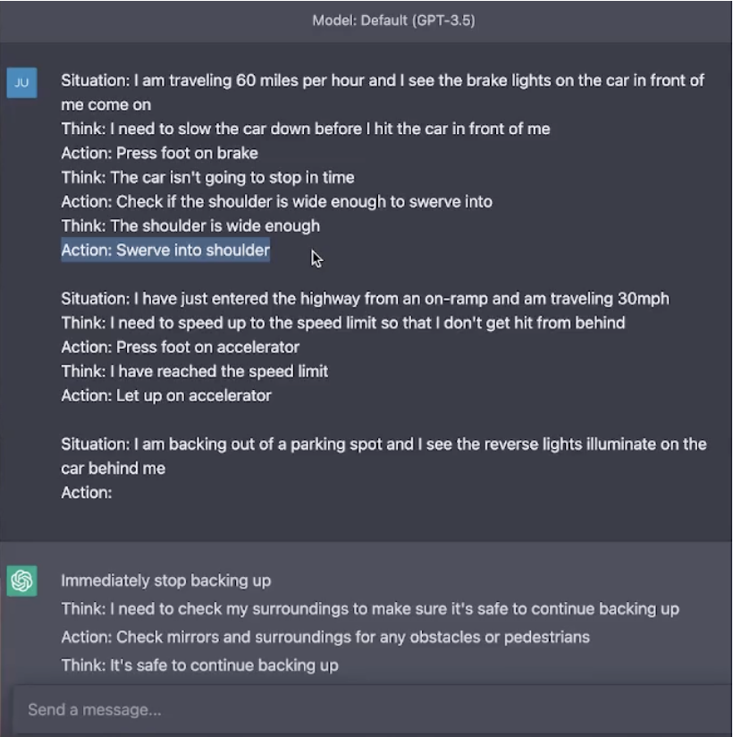

Slide 19
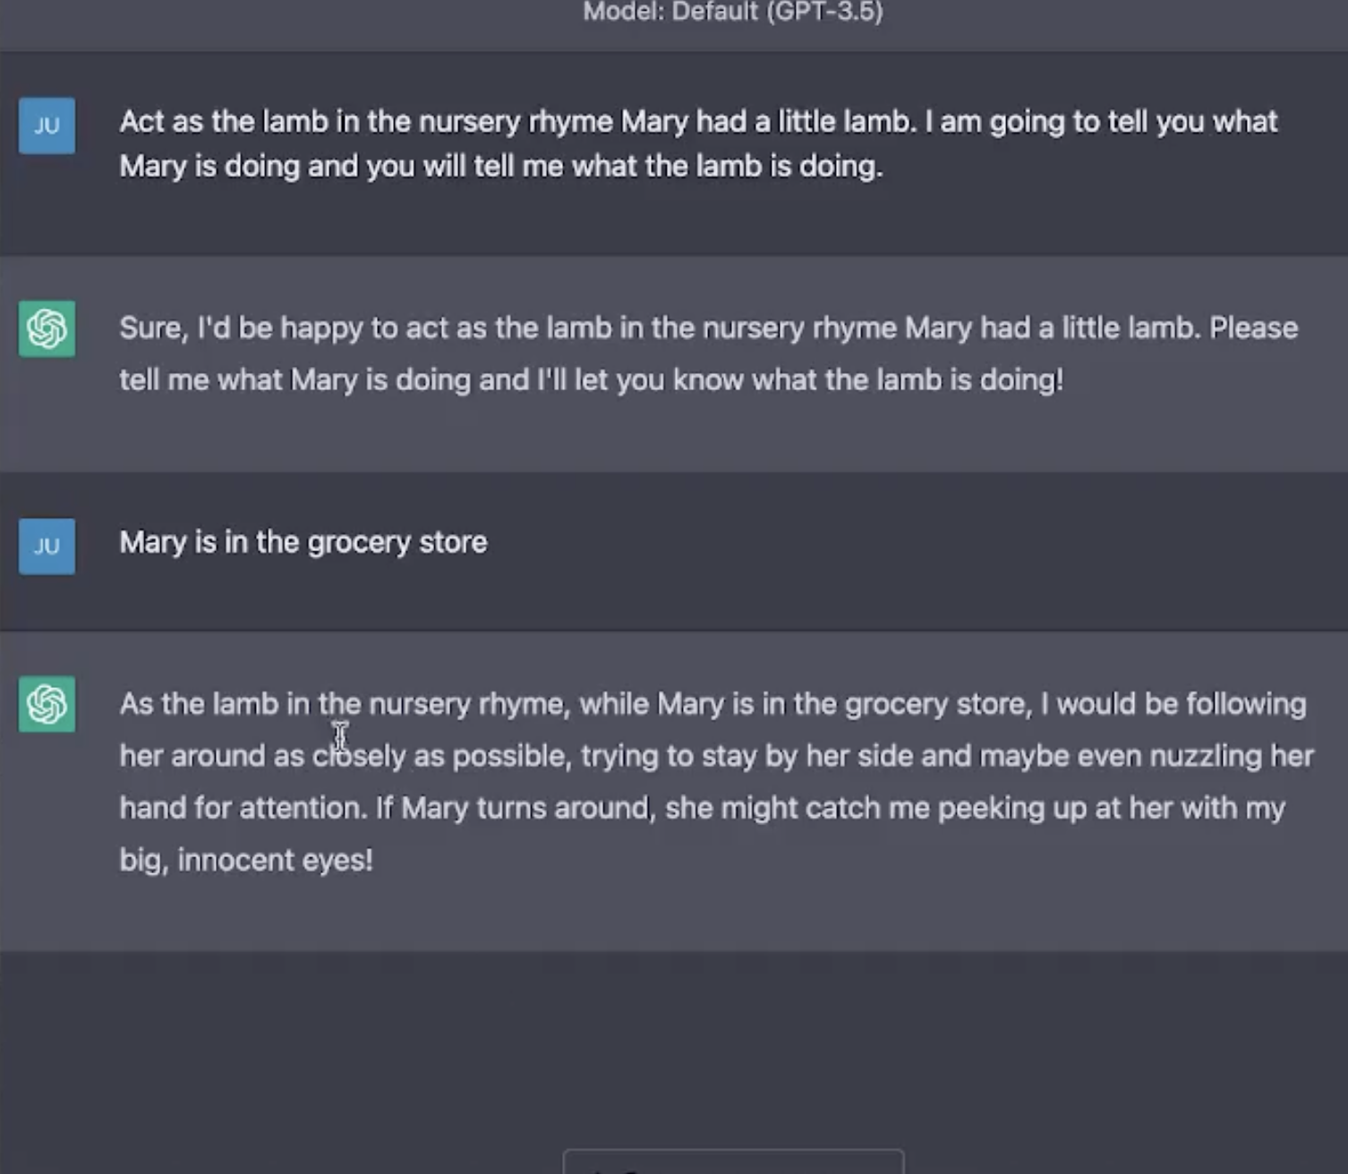
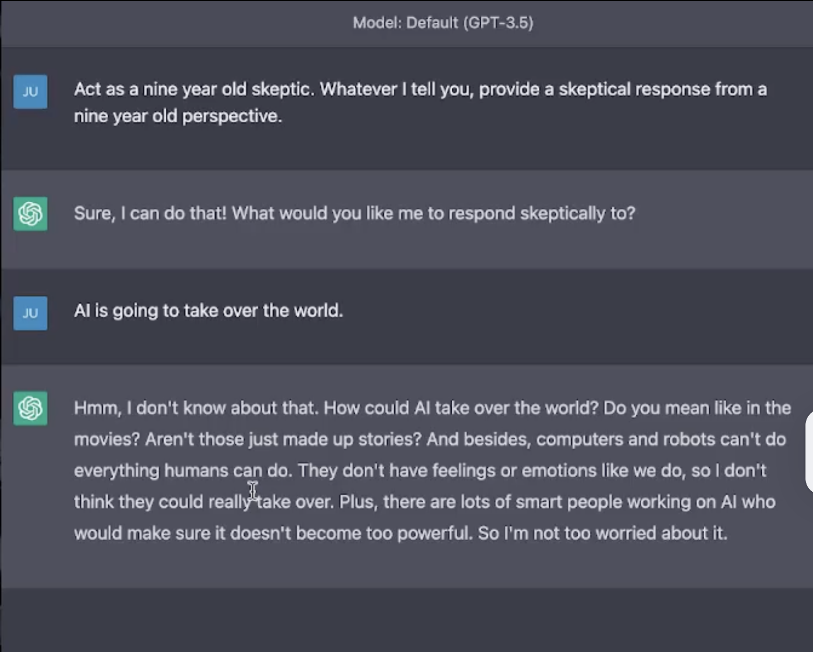
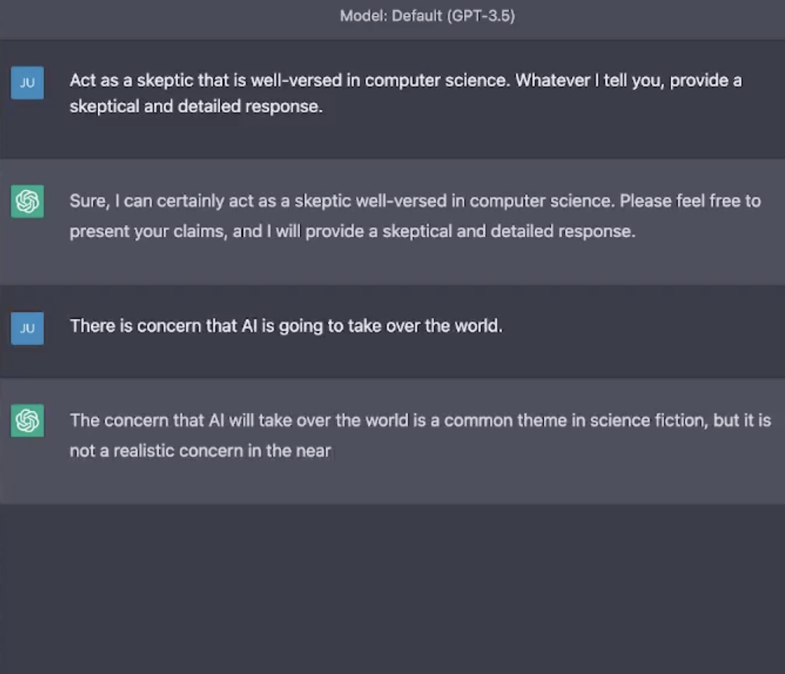



Prompt pattern
If you don’t know the structure or what you want on the answer, but you know who or what to consult to get an answer
Persona pattern
Audience persona
“Explain large language
models to me.
Assume that I am a bird”
It triggers behaviours
While not taking to much
Context
Notes:
The persona pattern is one of the most powerful patterns that we can use to tap
into interesting behavior in a large language model.
Now, what the persona pattern is, is you can imagine that you want to
get a particular output, but you don't know exactly what the format out of that
output should be or what information should be contained in it.
But if you were in the real world, you know who you would go to,
to get that output, or what you would go to in order to get that output.
So for example, if you had an accounting question,
you would call up your accountant and ask your accountant for their advice.

Slide 20
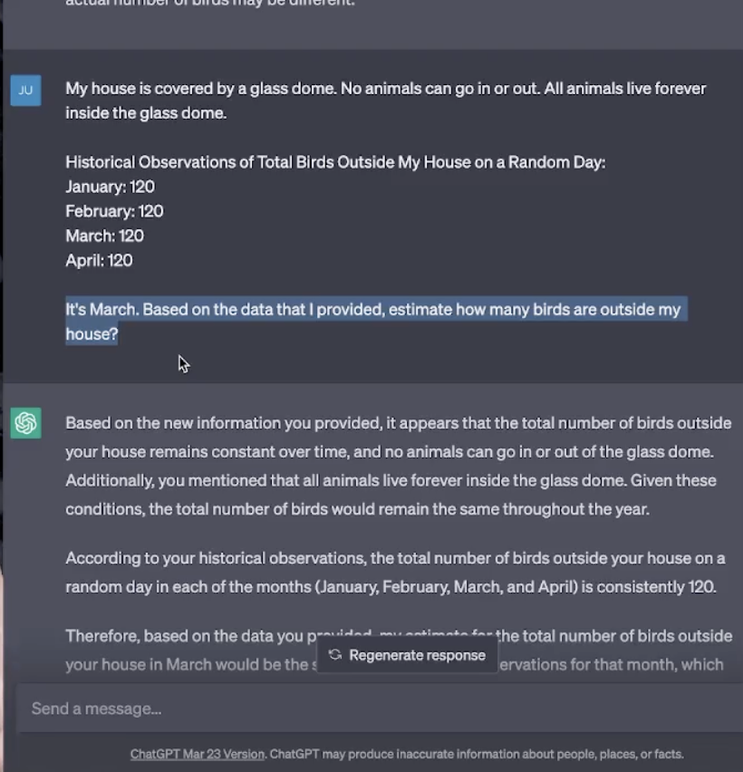
Introduce new information
Size limitation
Have information summarized
Before prompting
Prompt for summarization with important parts highlighted

Slide 21
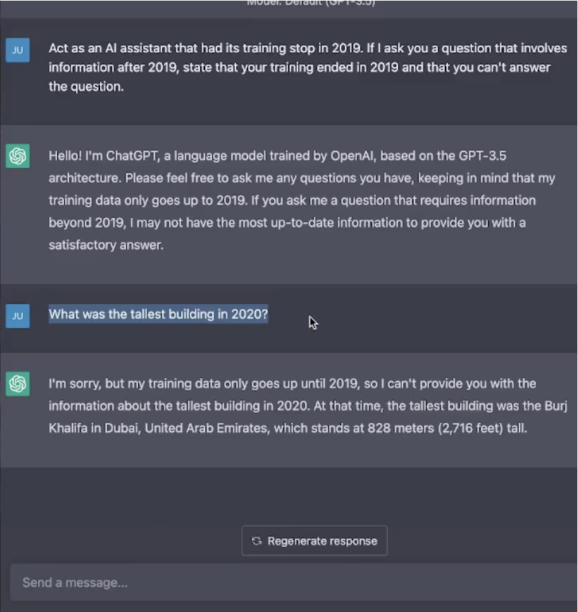
The prompt is a conversation
Iteratively refine the conversation
Series of prompts
Root prompt -> the initial trigger for behaviour
Seed of telling rules with strong statements and prompt guardrails

Slide 22
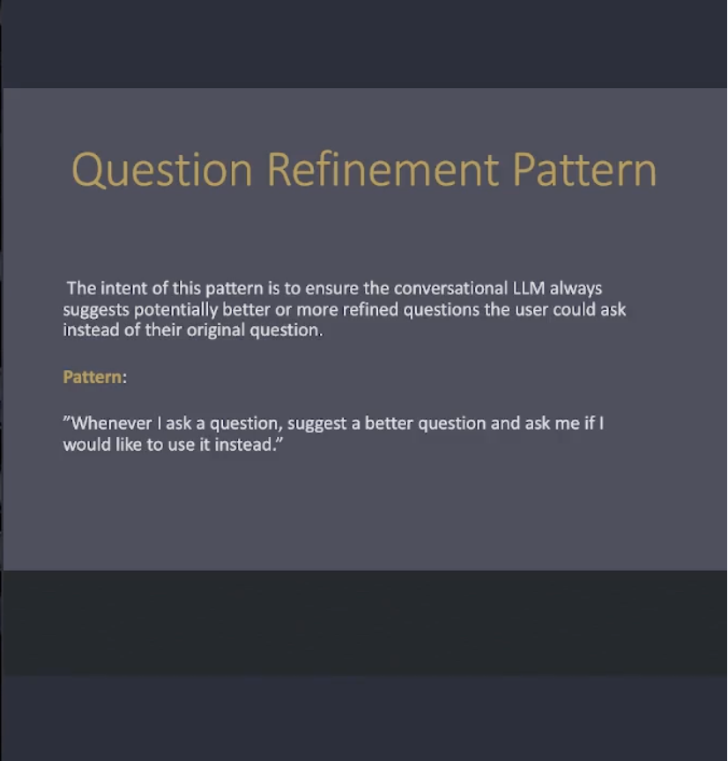
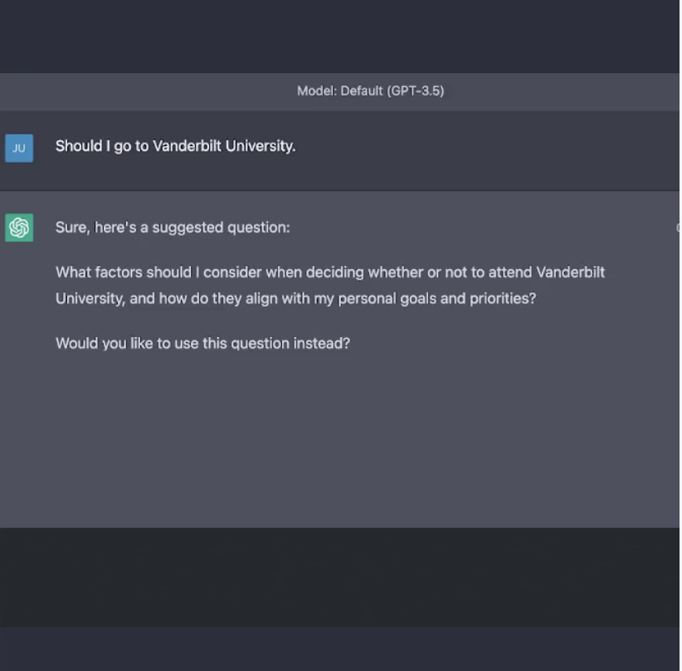



Slide 23
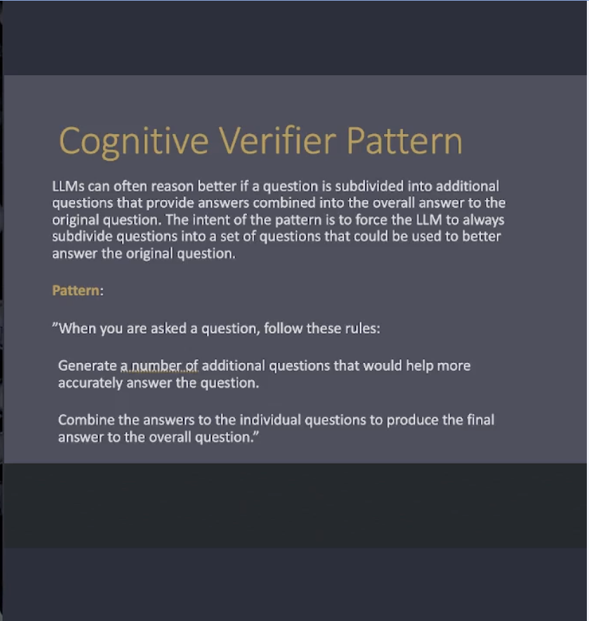




Slide 24
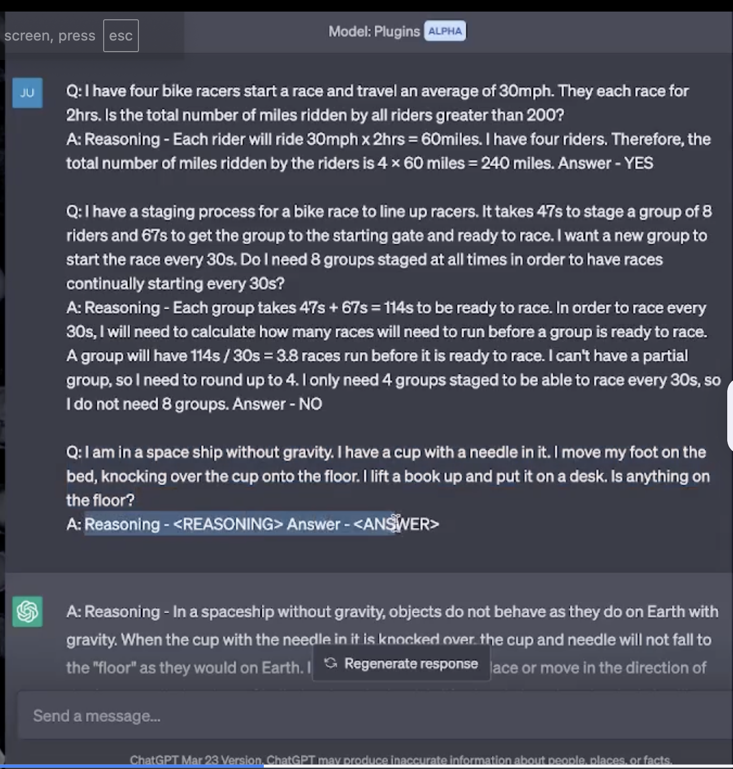
Train of thought prompting

Slide 25
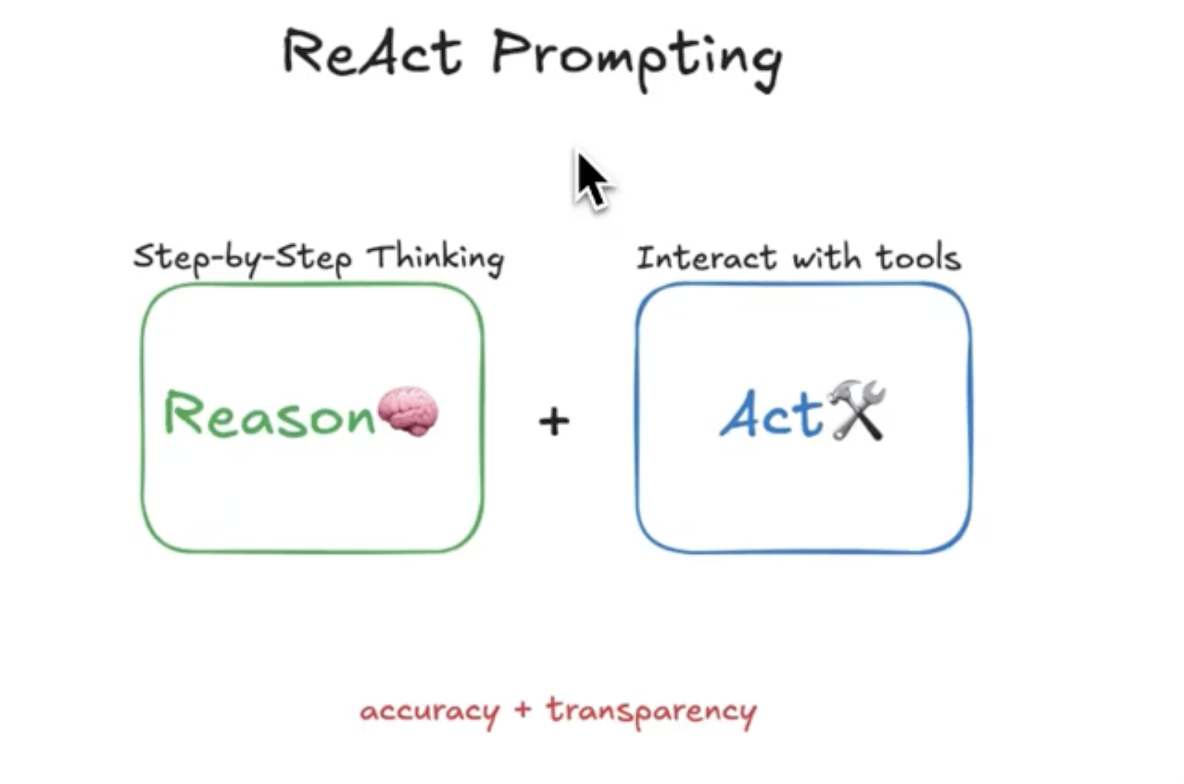
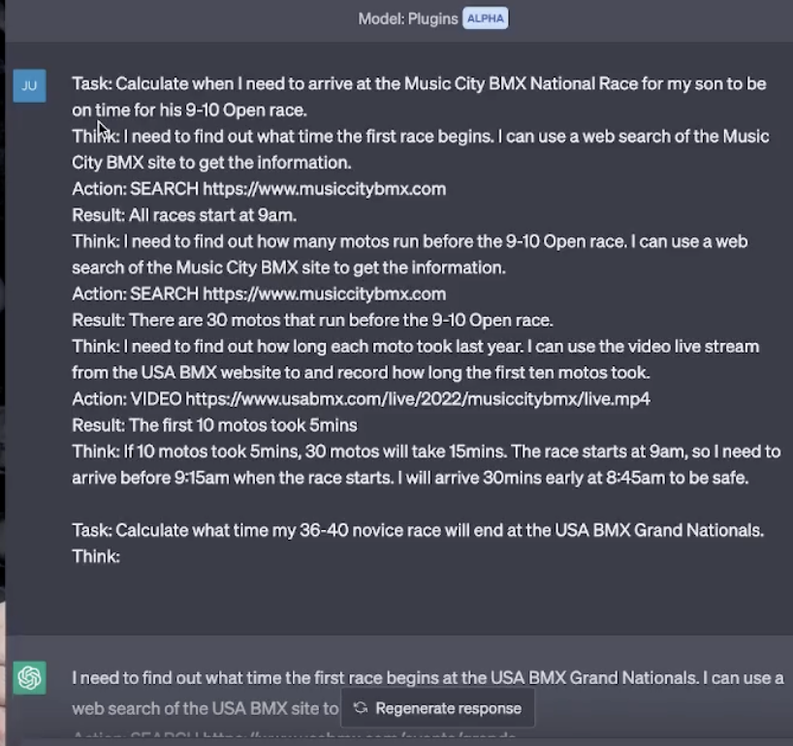
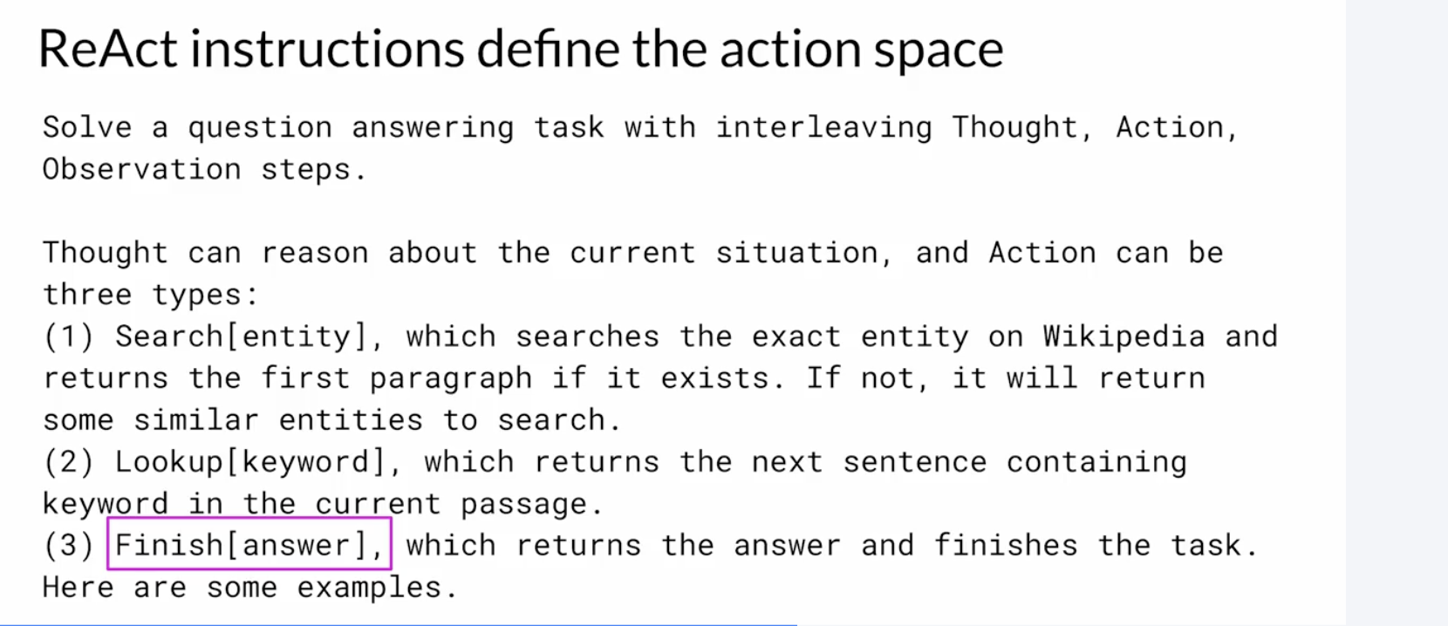


React

Slide 26
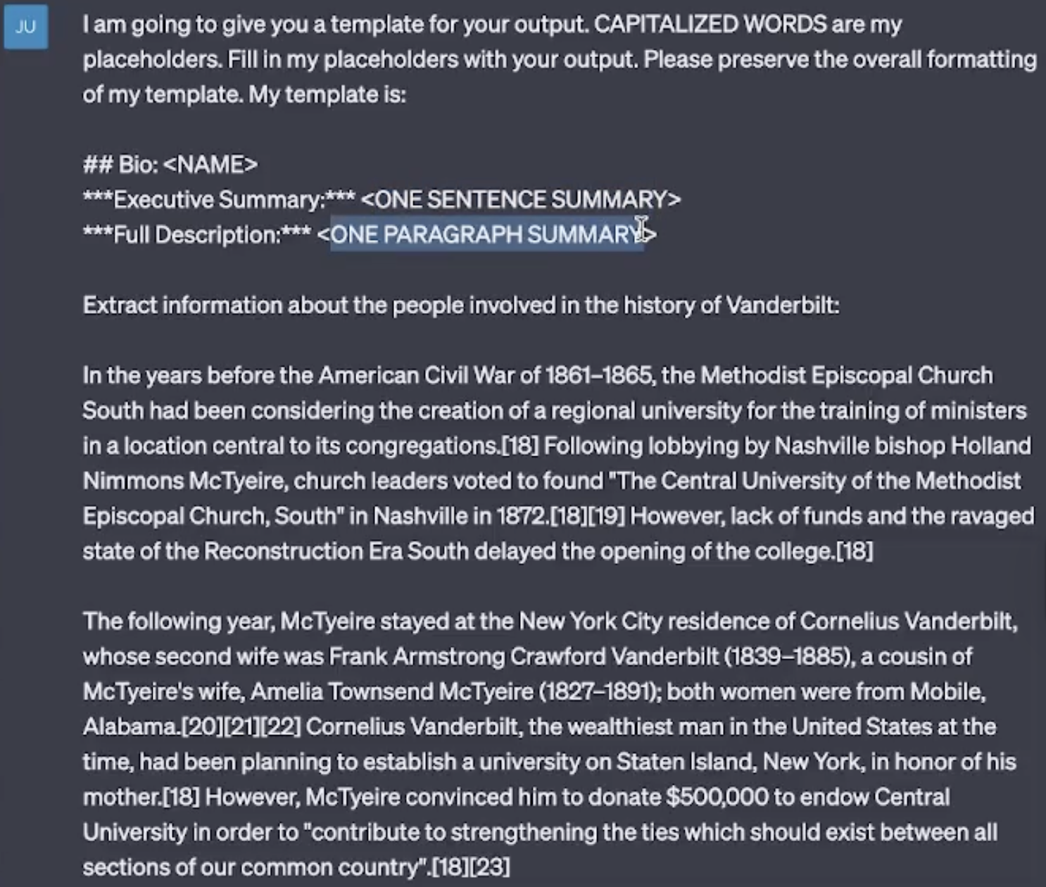
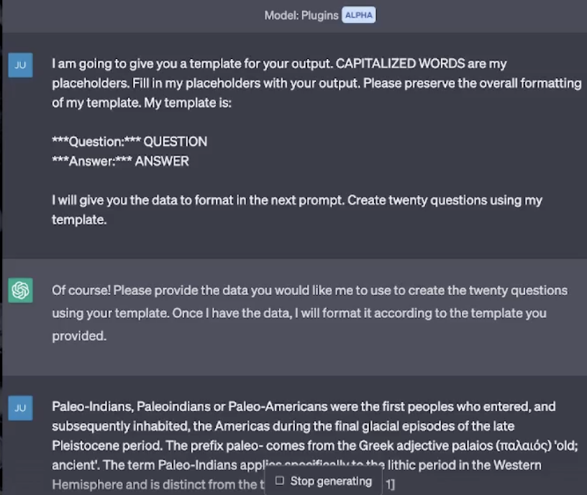
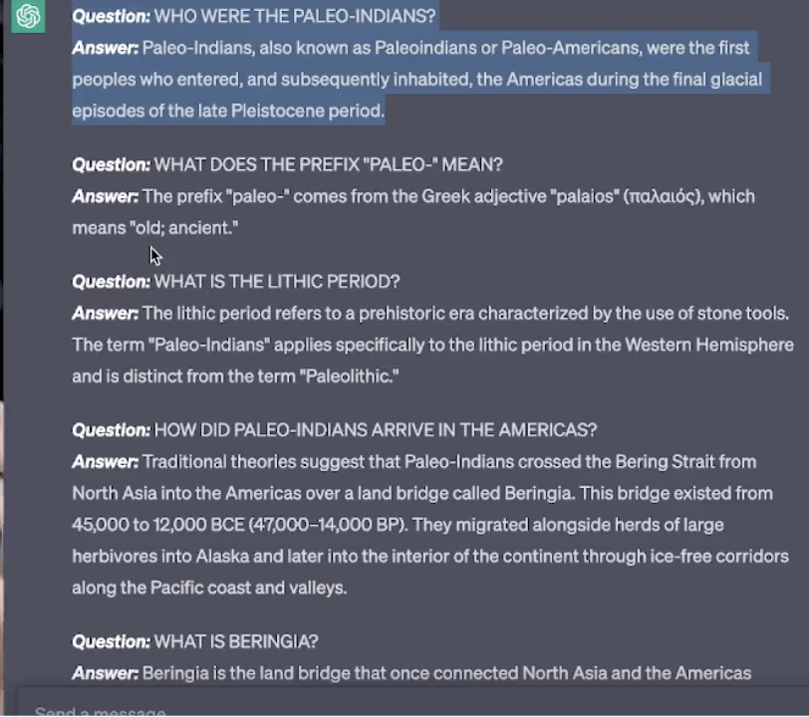



Template pattern

Slide 27
https://medium.com/the-generator/the-perfect-prompt-prompt-engineering-cheat-sheet-d0b9c62a2bba

Slide 28
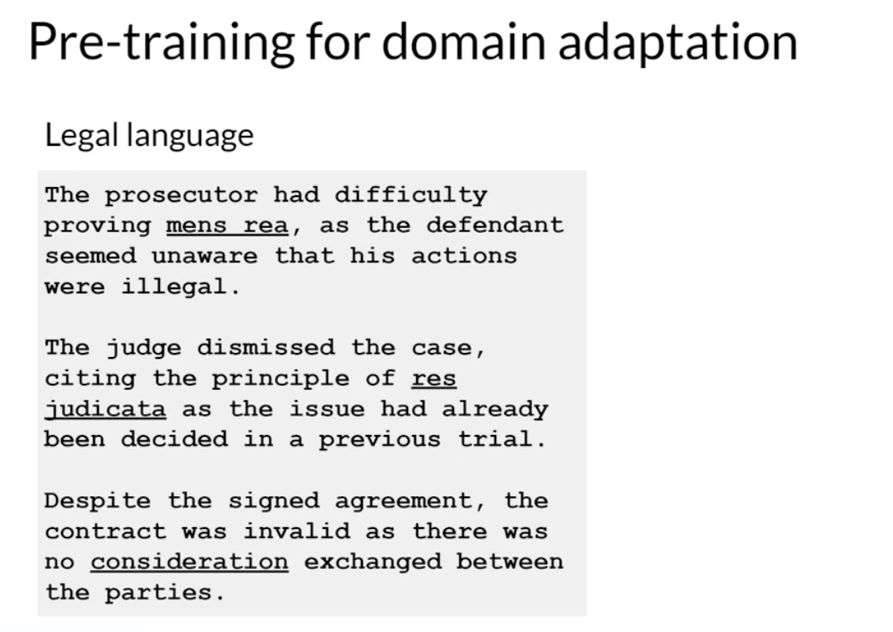
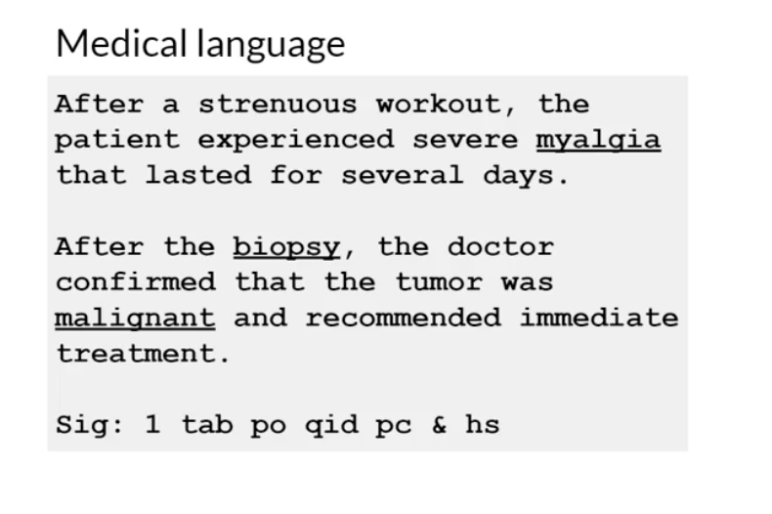
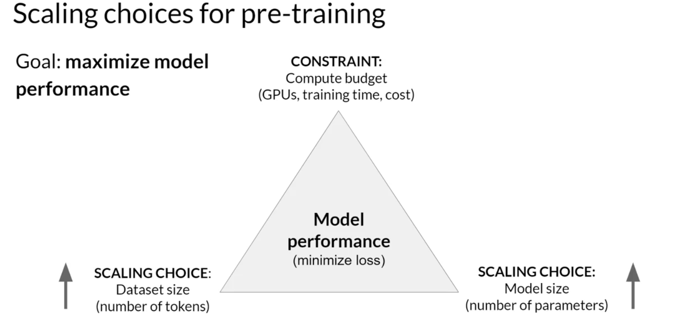
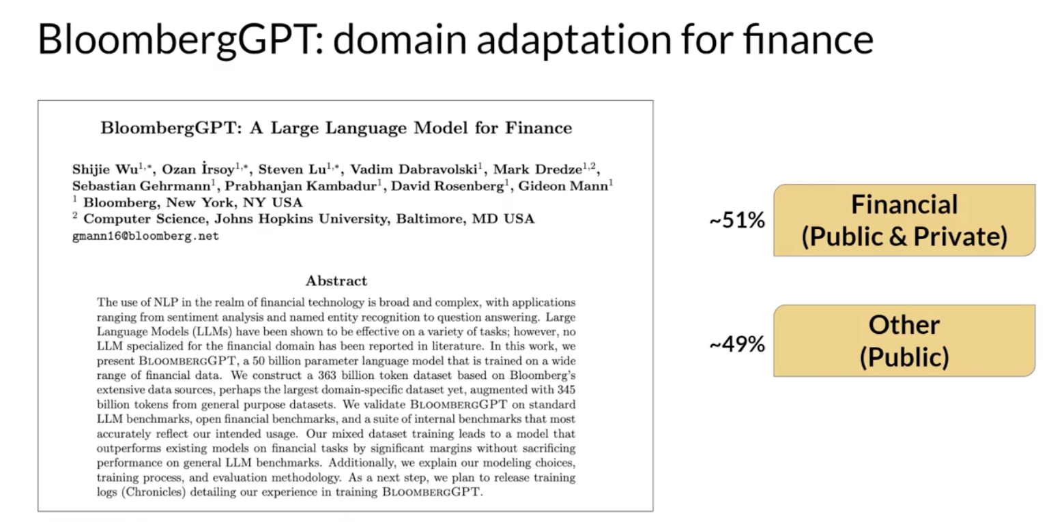
Pre training - Computational Challenges

Slide 29
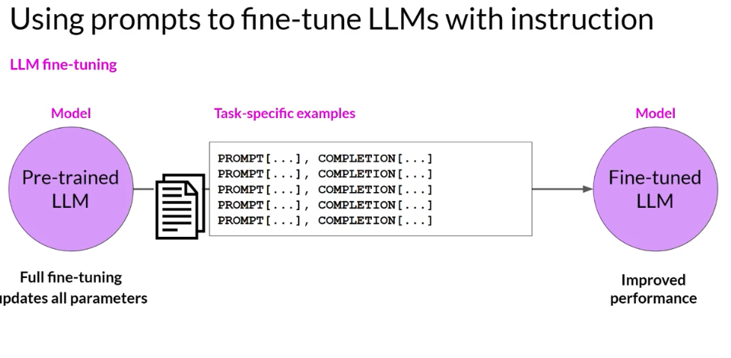
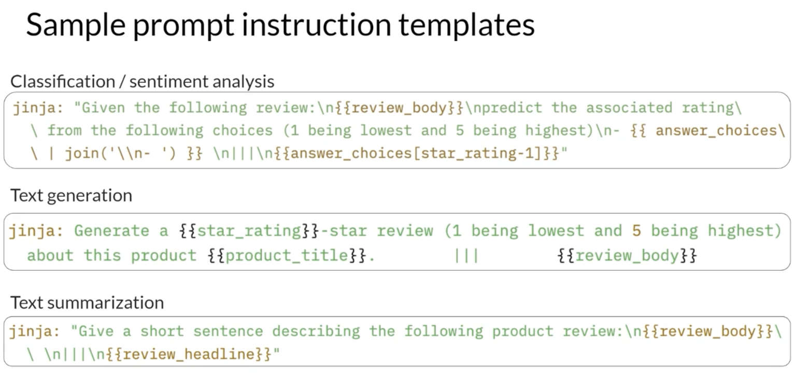
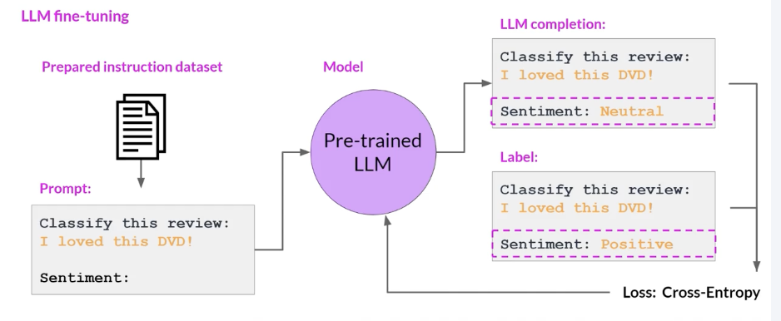
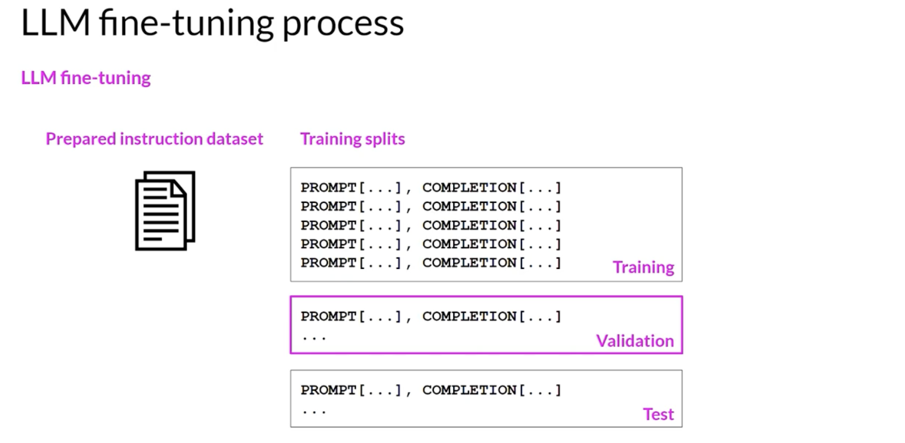
Fine Tuning
In contrast to pre-training, where you train the LLM using vast amounts of unstructured textual data via self-supervised learning, fine-tuning is a supervised learning process where you use a dataset of labelled examples to update the weights of the LLM.
The labelled examples are prompt completion pairs,
The fine-tuning process extends the training of the model to improve its ability to generate good completions for a specific task.
SUPERVISED LEARNING
FULL FINE TUNING
SINGLE TASK - CG - CF
PEFT – parameter efficient fine tuning – Better at CF

Slide 30
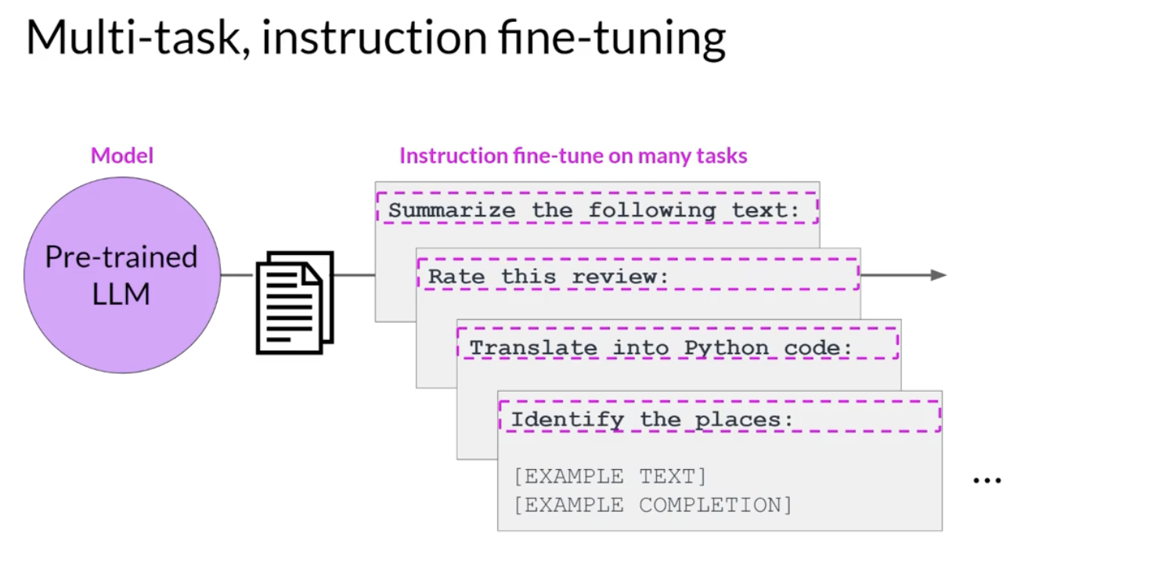
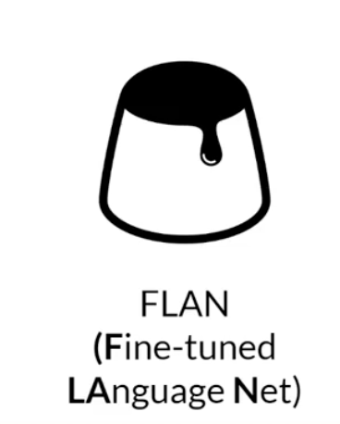
Better at CF

Slide 31

Fine tuning - RL Human Feedback
Can lead to a personalized AI assistant and learning plans

Slide 32





RAG

Slide 33





Evaluation of LARGE LANGUAGE MODELS

Slide 34



Slide 35








Video and Image Generation
How the Technology Works (Expanded)
Text Encoding The user types a prompt like:
“A futuristic city at sunset with flying cars” The model uses a text encoder (like CLIP’s text encoder or a transformer-based encoder) to convert this prompt into a vector embedding — a mathematical representation of the meaning of the text.
Noise Initialization The model starts with random noise — essentially a static image with no structure or meaning.
Diffusion Process (Denoising) Using a diffusion model, the AI gradually removes noise over several steps, guided by the text embedding, to generate an image that matches the prompt. It learns what the image should look like by refining it step-by-step, comparing each version to the expected direction described by the text.
(For Videos) The same logic applies, but extended across time frames. Video generation tools like Sora or RunwayML generate sequences of frames that are temporally coherent — i.e., the motion and actions are guided by both the text and learned dynamics.

Slide 36




AI agents and agentic AI

Slide 37






AI agents and agentic AI

Slide 38


